Slide 1
Creating Human-like Fighting Game AI through Planning
Presenter: Roger Liu
Advisor: Maxim Likhachev, Committee Member: Jessica Hodgins

Slide 2
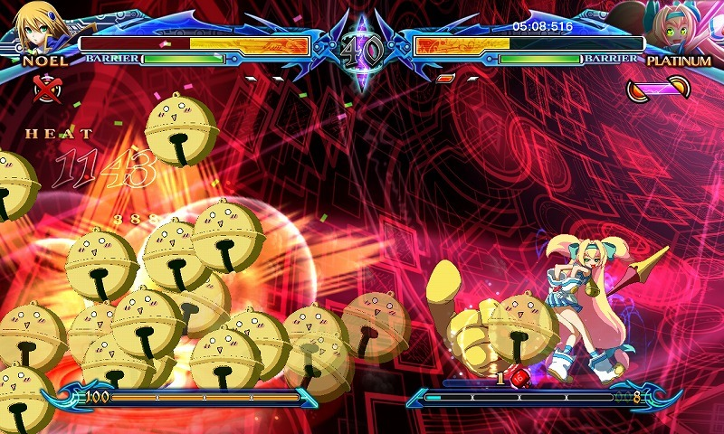
Motivation
Current Fighting Game AI is a poor substitute for human-play
Abuses perfect execution and state information
Has a fixed set of behavior patterns which can be exploited
Optimal AI strategies are not indicative of those of real human players

Slide 3
Purpose
The goal of this research is to explore and evaluate techniques that mimic player behavior in fighting games

Slide 4
Related Work
Player driving styles in racing-games
Used evolutionary algorithms to try to replicate elements of driving style
Trade off of robustness and mimicry
Optimal AI for Super Smash Bros. Melee
Deep Reinforcement Learning
Long training time. Very strong at playing the game
N-gram and GhostAI
Use histogram of players actions to guide decision making
GhostAI learns the moves that give more reward
Doesn’t capture aspects like player’s sense of timing
Notes:
Before we talk about our approach, lets go over a some other approaches
Etc.

Slide 5
Topics
Domain Introduction
Environment Description
Search Representation
Demonstration 𝛿-Search
Demonstrations
Action- 𝛿’s
𝛿-Search
Implementation Details
State Similarity
Full AI Framework
Additional Improvements
Results

Slide 6
FG
We implemented a simple fighting game FG as our testbed
A variety of actions are available to players
There are a variety of attacks with situational uses
These attacks can be defended against if they are blocked correctly
There are many ways to move around the arena such as jumping, walking, and dashing
Notes:
Spend more time on explaining the game
Mention: In order to navigate the FG domain, we use search

Slide 7
Why Use Search?
Allows for the AI to form long coherent strategies to hit the opponent
Similar to how players have form strategies during gameplay
Actions are purposeful and are less likely to be contextually inappropriate
The agent commits to performing goal-directed behaviors
Notes:
One component lacking from prior research is the ability to form strategies
This is important because a large part of enjoying and playing fighting games is understanding the opponents strategies and overcoming them with your own

Slide 8
Search Representation
Game State: State of player 1 and player 2
Player State:
Position (Discretized x and y)
Velocity (x and y)
Grounded Status
Status (standing, crouching, attacking etc.)
Actions:
Duration: Number of frames it was performed for
Type: 21 Types:
Stand, WalkLeft, JumpNeutral etc.
Notes:
Mention what grounded status means

Slide 9
Search Representation (cont.)
State Successors
The state s’ that results from taking action a from state s is obtained from a learned model of the world dynamics
Goal States:
States are where the opponent is hit with an attack or has to block an attack
Goal states selected randomly to simulate how players alter strategies
Notes:
This is a high level overview and we’ll be going in more detail later

Slide 10
Search Representation (cont.)
Goal States:
States are where the opponent is hit with an attack or has to block an attack
Heuristic:
Distance between the current state and the goal state
Notes:
Introduce using demonstrations all at once
Add this to the later section about selecting the goal state
Also motivate why we’re randomly selecting the goal
The goal is randomly selected from the set of viable goal states seen in the demonstration data

Slide 11
Topics
Domain Introduction
Environment Description
Search Representation
Demonstration 𝛿-Search
Demonstrations
Action- 𝛿’s
𝛿-Search
Implementation Details
State Similarity
Full AI Framework
Additional Improvements
Results

Slide 12
Demonstrations
Provides the agent with a set of goals that it should try to achieve
Describes actions that the agent can use to achieve those goals
What kind of action can be used
The effects of that action
The AI player uses the tools of the player it is mimicking to produce convincing behavior
Notes:
Natrually, since our AI is trying to emulate human behavior, it needs some demonstration to base itself on.
Describe why we are using demonstration and how the demonstrations help us achieve the goal of human-like AI

Slide 13
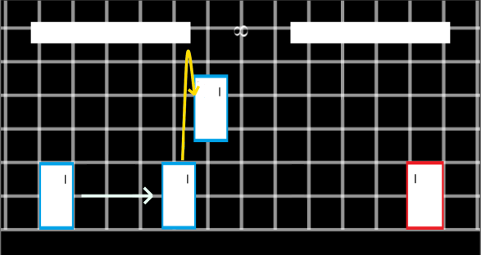
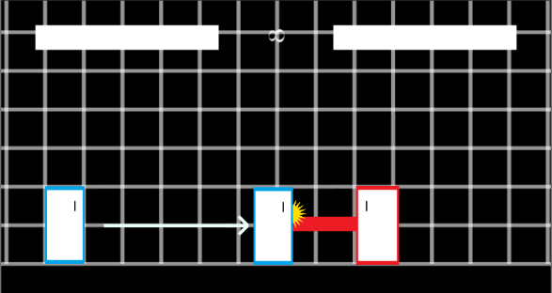
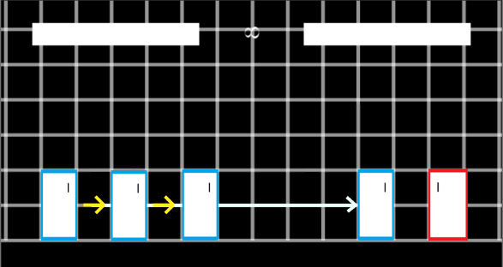
Demonstration Data Extraction
Transitions (s, a, s’) are extracted from the demonstration in different circumstances
During the start of a new action
When the current action is interrupted
When the game state changes during the current action

Slide 14
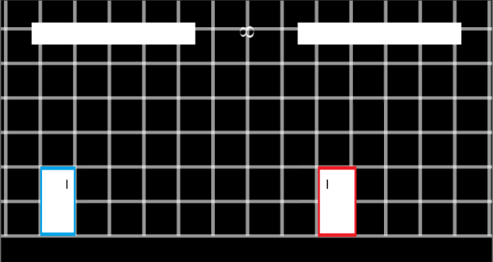
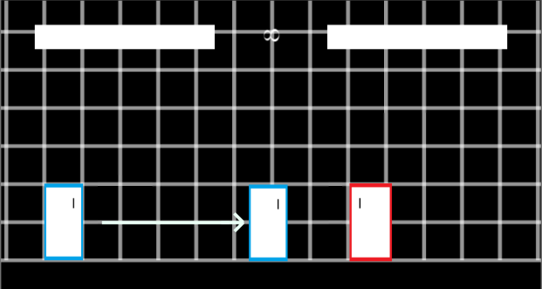
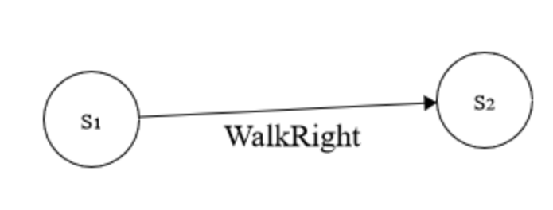
Forming the plan
The demonstration contains transitions (s, a, s’)
If we see s, then we generally know that performing action a will lead to state s’
For an unknown tuple (s*, a*) we need to make a prediction
Notes:
Always refer to using delta-transitions in the context of unknown tuples. As we could take an unknown action from a known state
EMPHASIZE THIS

Slide 15
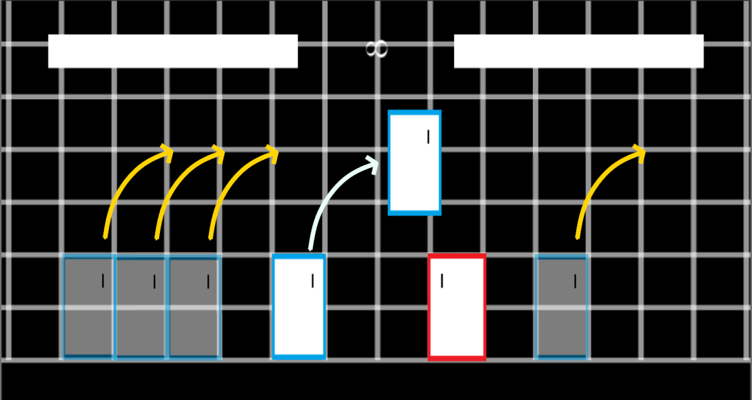
Action-𝛿’s
When performing an action, the state of the world changes
The effect that the action has on the world is called an action-𝛿
Jumping to the right has a consistent effect on the player’s position

Slide 16
𝛿-Transitions
𝛿-Transitions are transitions that use action-𝛿’s to predict the result of taking action a at state s
Predictor function s’ = ϕ(s,a)

Slide 17
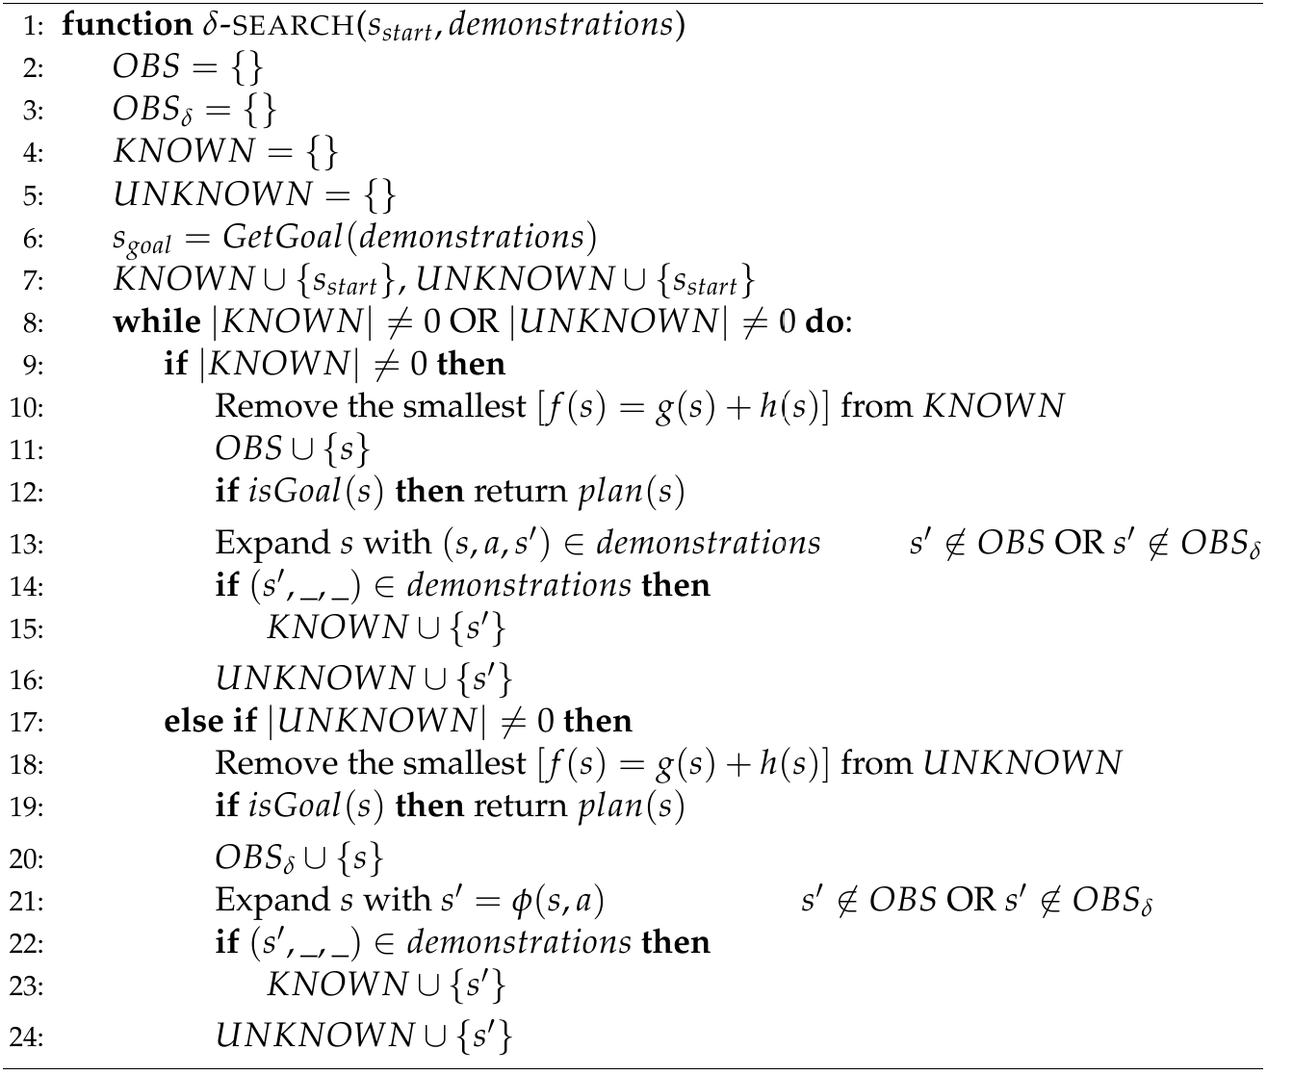
𝛿-Search

Slide 18
𝛿-Search
Initilaize OBSERVED states
Initialize KNOWN and UNKNOWN
priority queues
Select a Goal State
Notes:
Known states have need to be expanded using KNOWN-transitions
Unknown states have need to be expanded using delta-transitions

Slide 19
𝛿-Search
Prioritize expanding the states in the KNOWN queue
Prefer to expand Known-Transitions first

Slide 20
𝛿-Search
Non-goal States which have not been expanded by both 𝛿-Transitions and Known-Transitions are expanded and added to the correct Queue

Slide 21
𝛿-Search
When there are no more states in the KNOWN queue, expand states in the UNKNOWN queue
This process continues until a goal state is reached

Slide 22
Advantage of 𝛿-Search
𝛿-Search favors reduces the number of expansions by first prioritizing actions that make use of transitions shown in demonstration

Slide 23
Topics
Domain Introduction
Environment Description
Search Representation
Demonstration 𝛿-Search
Demonstrations
Action- 𝛿’s
𝛿-Search
Implementation Details
State Similarity
Full AI Framework
Additional Improvements
Results

Slide 24
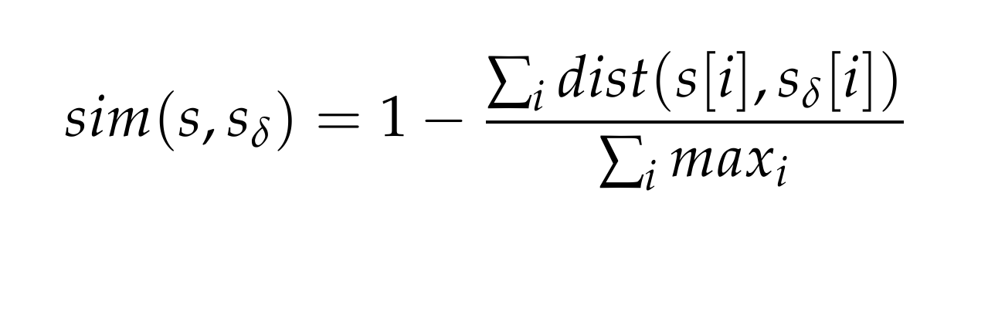
State Similarity
Gives the AI some way of relating unseen states to states seen in the demonstration
Used in the predictor function
Notes:
Add a bullet that mentions where the state similarity is useful in the algorithm
Make sure to orient people as to why this value is useful

Slide 25
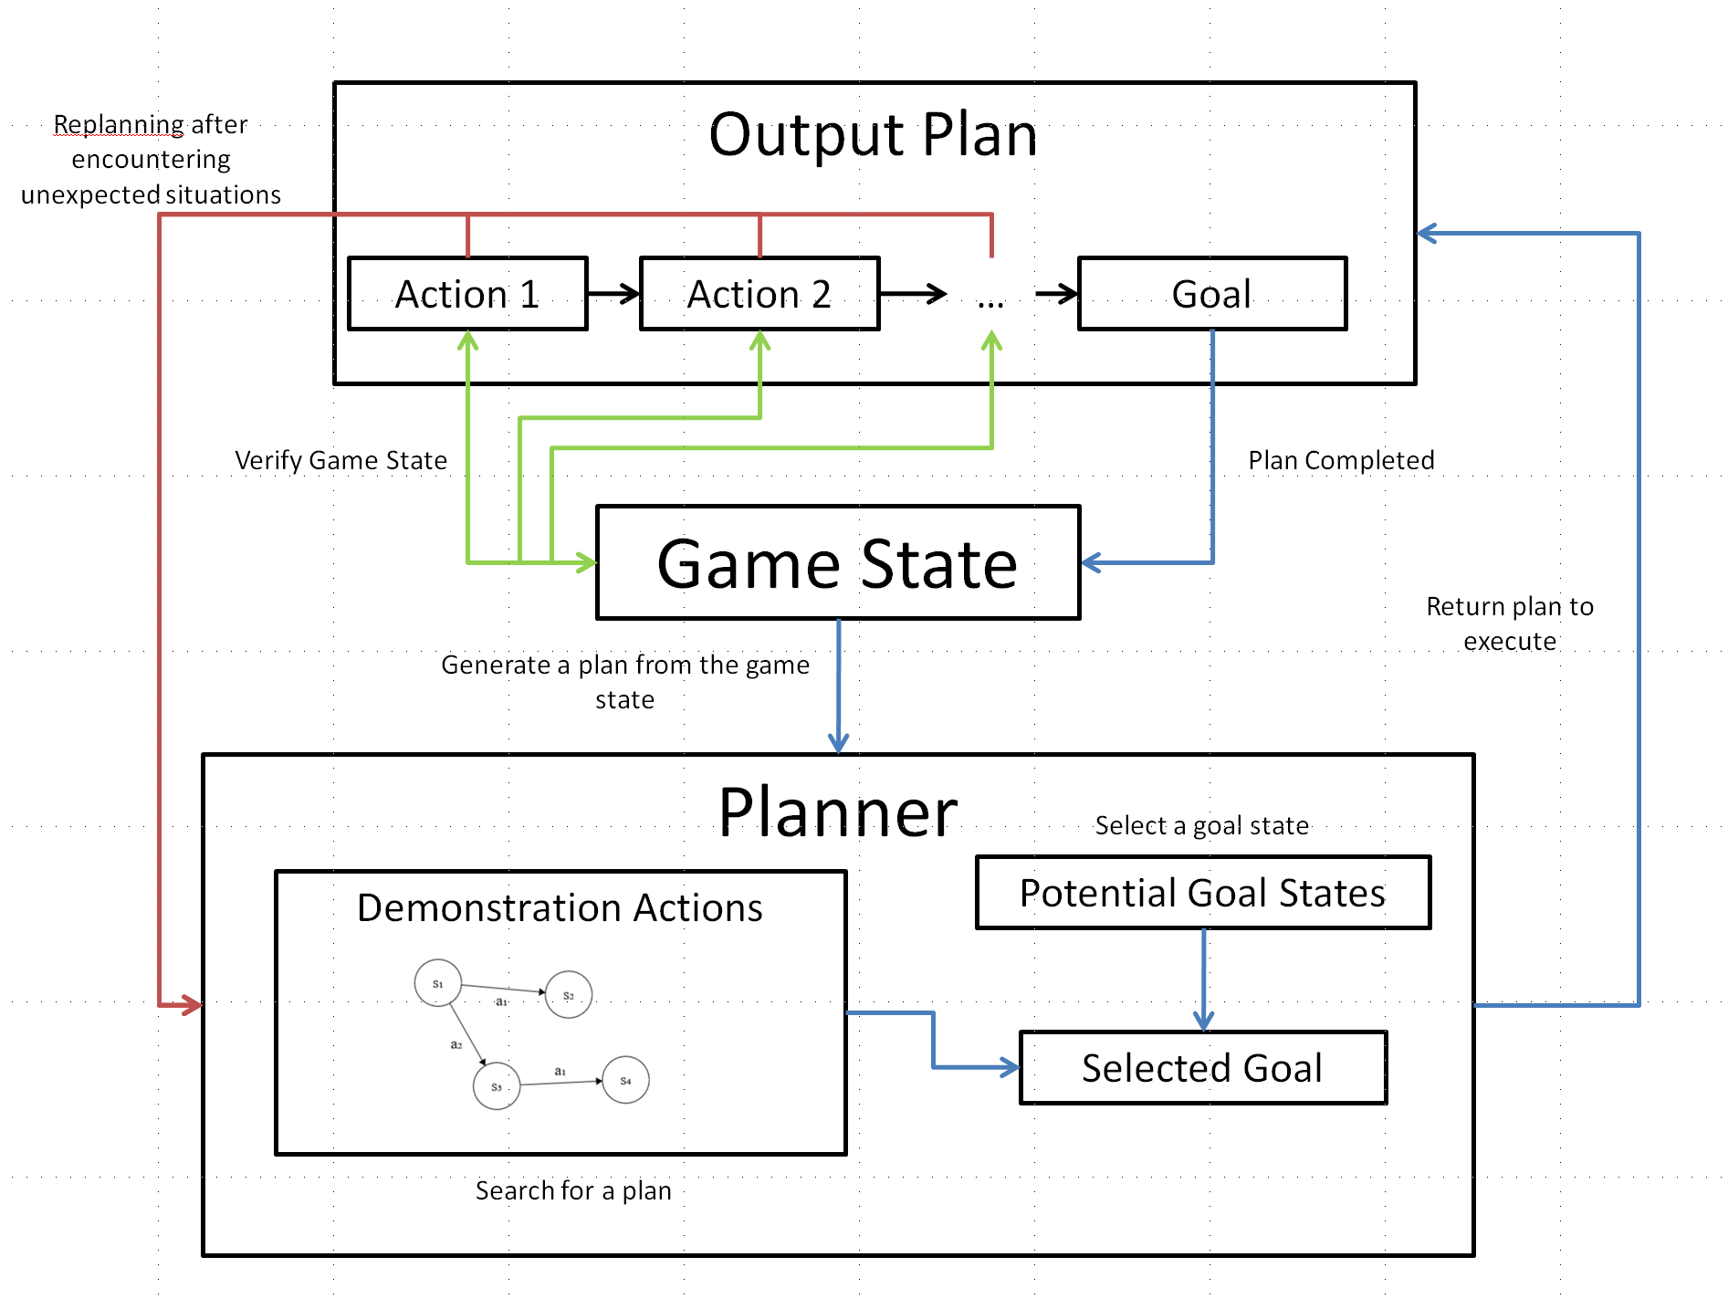
Full Framework

Slide 26
Selecting Goal States
Goal States from demonstration
FreshHit
FreshBlock
Random selection weighted by similarity to current state
FreshHit:
w(s) = sim(s, s_{curr})
FreshBlock:
w(s) = sim(s, s_{curr}) * 0.3
Random selection emulates the players tendencies to employ different strategies

Slide 27
Generating Successors
Known-Transitions are simply (s, a, s’)
𝛿-Transitions use s’ = ϕ(s,a)

Slide 28
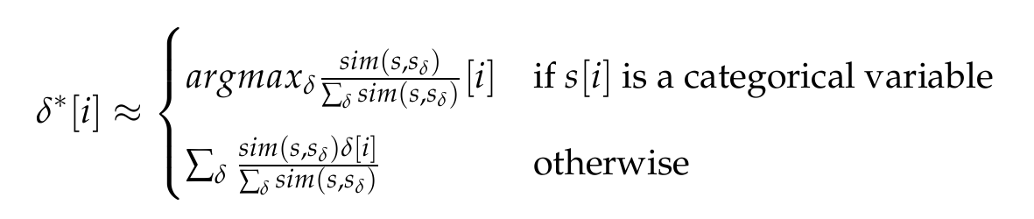
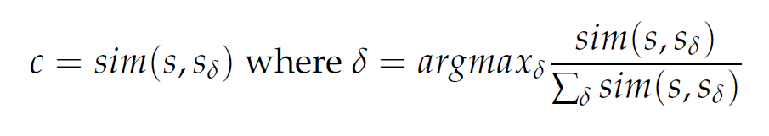
Generating Successors (cont.)
ϕ(s,a):
Generate 𝛿*, an action-𝛿 that is the weighted avg of the action-𝛿’s of action a
Apply 𝛿* it to s to get s’
Return a confidence value c

Slide 29
Cost
Cost Function:
The cost of taking an action a from state s is inversely proportional to the confidence in the predicted resulting state s’
Transitions (s, a, s’) with higher confidence have lower cost

Slide 30
Cost
Known-Transition Cost = 1
𝛿-Transitions Cost: λ/c where λ is a hypervariable

Slide 31
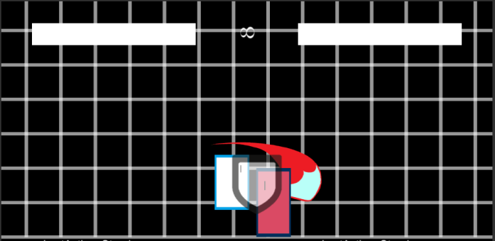
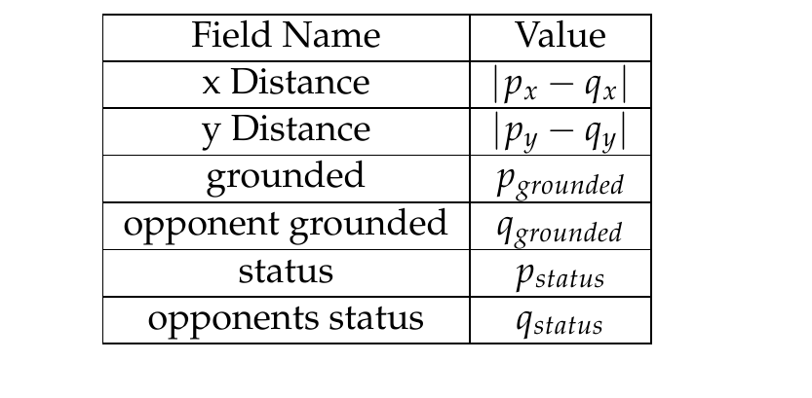
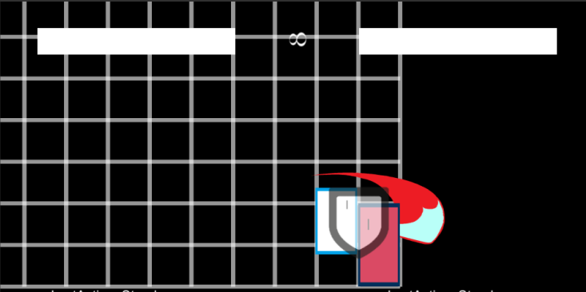
Heuristic
Distance between desired qualities of the solution
Demonstration Goal State:
Desired Quality:
Equivalent Goal State:

Slide 32
Real-time Search
Because Fighting Games are fast paced, the AI has to return a plan very quickly.
Sub-50 ms
Returns a plan to an expanded s_{goal}* where sim(s_{goal}, s_{goal}*) is minimized
Such a plan exists because a state is expanded if there exists a path from s_{start} to it
Notes:
Say that we need to satisfy-realtime conditions
Add a bullet:
Explain that we pick a plan to s_goal* where sim(s_goal, s_goal*) is minimized
Add a bullet:
Because that state has been expanded, we already have a plan to that state
It’s a property of all searches that once a state has been expanded, we have a path from the start to that state

Slide 33
Replanning
The environment is non-static as the opponent performs actions
Replan when the state differs from what was expected in the plan

Slide 34
Update the predictor
Test time opponent does not behave the exact same as in the demonstration
Can get stuck creating the same inefficient plans
Learn from bad predictions by including those transitions

Slide 35
Topics
Domain Introduction
Environment Description
Search Representation
Demonstration 𝛿-Search
Demonstrations
Action- 𝛿’s
𝛿-Search
Implementation Details
State Similarity
Full AI Framework
Additional Improvements
Results

Slide 36
Experiment
Players were first acclimated to the game controls and allowed to play
They then fought against a simple defensive computer opponent for five 20-second periods
One of these sessions was used as the demonstration set. An N-gram based AI, GhostAI, and our Search AI were formed from that demonstration set
The agents then also fought the same defensive computer opponent

Slide 37
N-gram and GhostAI
N-gram
Sequence: a, a, a, b, a, a, b
Pick according to Hist H:
GhostAI
Separate Histogram for each game state
Weights for sequences adjust as AI gets rewards
Sequence s | Count
a,a,a | 1
a,a,b | 2
a,b,a | 1
b,a,a | 1

Slide 38

Results-Footage
Player
N-gram
Ghost
Search AI
Notes:
Ngram-stutters
Ghost never does the jump attack

Slide 39
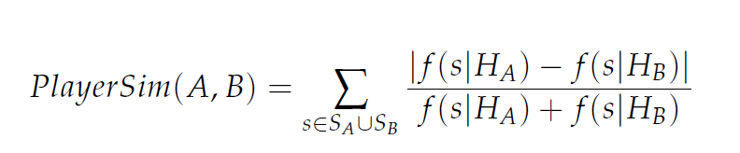
Results-Similarity Stats
Similiarity Measure:
 | Cross Validation | Ngram | GhostAI | SearchAI
Mean | 0.447 | 0.224 | 0.265 | 0.248
Standard Dev. | 0.078 | 0.047 | 0.036 | 0.034

Slide 40
Results-Efficiency Stats
Hits Landed
Hits Landed Std:
Actions per Hit:
 | Original Player | Ngram | GhostAI | SearchAI
Mean | 6.75 | 2.6 | 2.35 | 4
Standard Dev. | 1.55 | 1.162 | 0.683 | 1.368
 | Original Player | Ngram | GhostAI | SearchAI
Mean | 10.54 | 22.49 | 36.83 | 11.45
Standard Dev. | 3.77 | 11.54 | 19.39 | 2.66

Slide 41
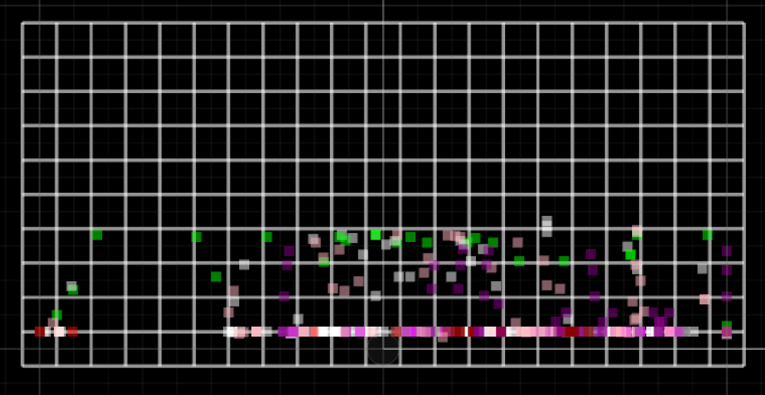
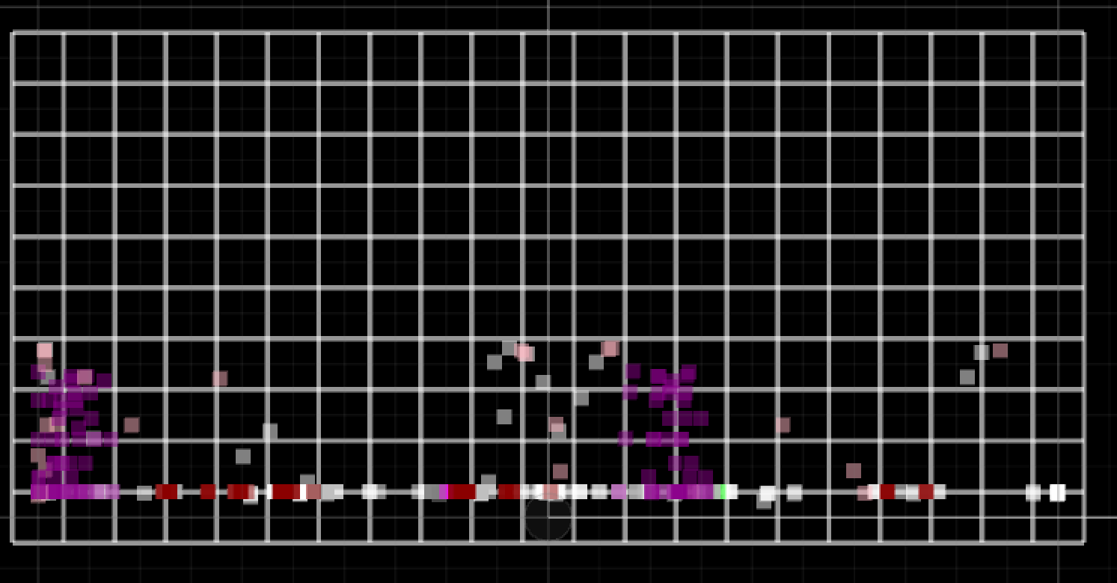
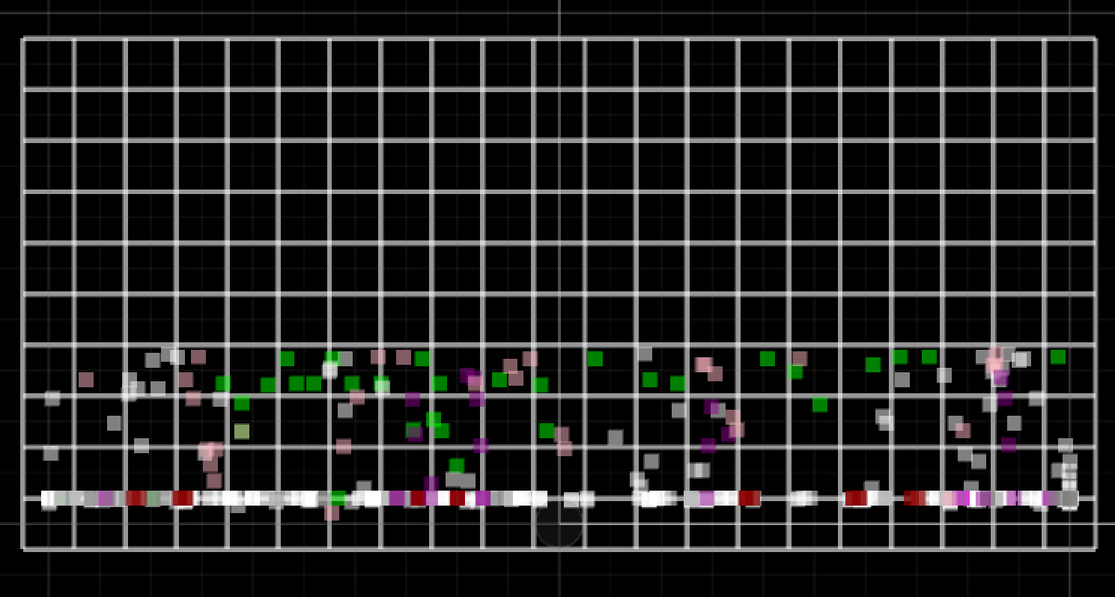
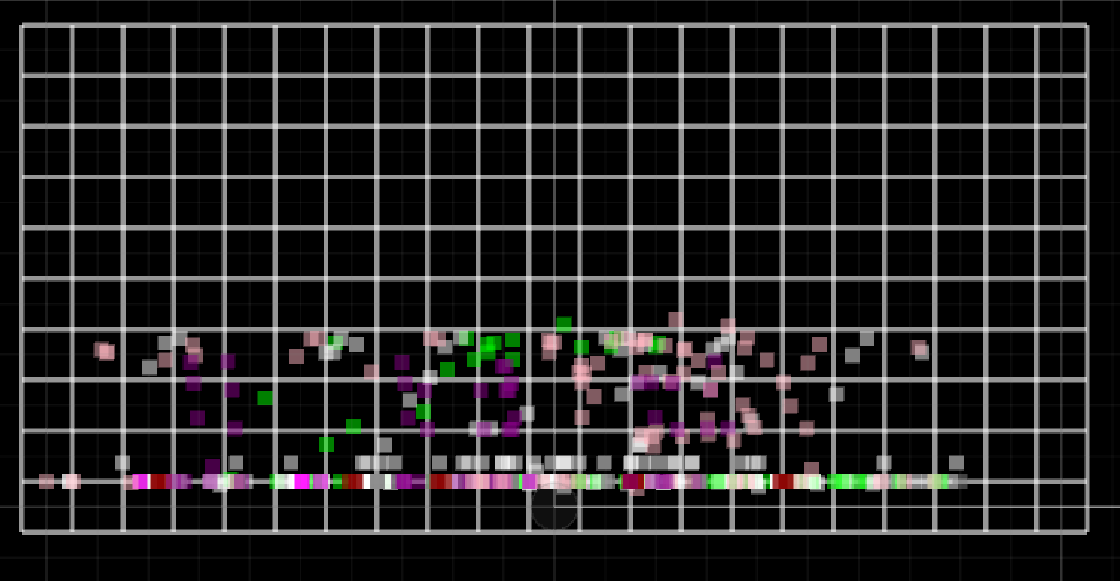
Results-Heatmaps
Original
ngram
GhostAI
SearchAI

Slide 42
Summary
Developed an AI which uses search to form plans that mimic human-behavior
Formulated the idea of action-𝛿’s and described how they are used to allow the AI to build a model of the world from a limited demonstration
Experimental results showed that the AI was the best at matching the human’s performance
Despite not recording the same similarity stats as other demonstrations, it still exhibited desirable qualities of human-play

Slide 43
Future Work
Improve the predictor function using with more advanced AI techniques
Improve the AI’s ability to use large datasets

